Slide 1
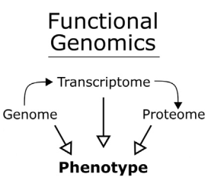
Functional Genomics
We now know the structure of a genome, but which parts contribute to a phenotype?
Genomic DNA -> Infer function from DNA Sequence -> Homology modelling with BLAST
Transcriptome -> Measure RNA levels under different conditions -> Stress response?
Proteome -> What proteins are in a cell/organism at a specific moment?
1
Notes:
Functional Genomics via CRISPR–Cas

Slide 2
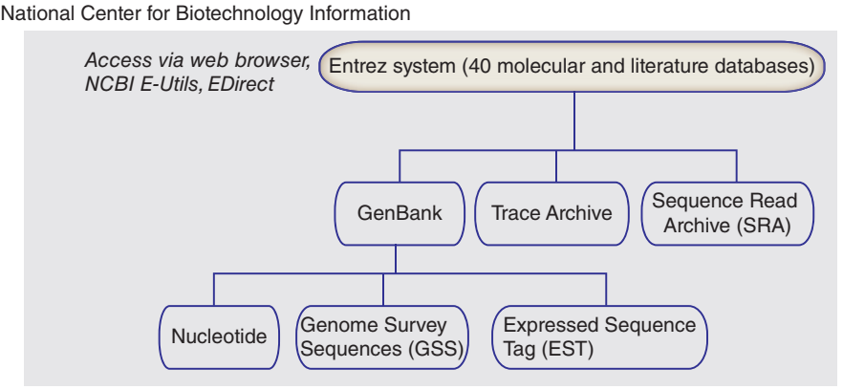
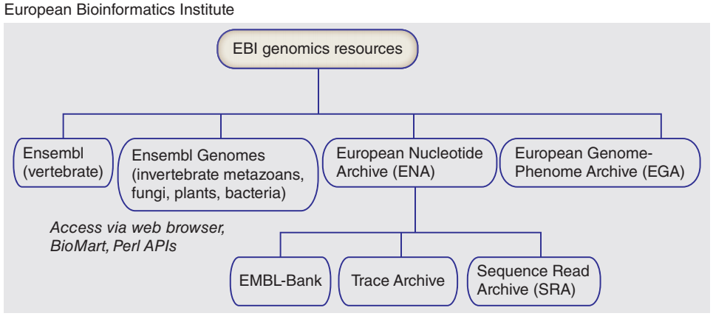
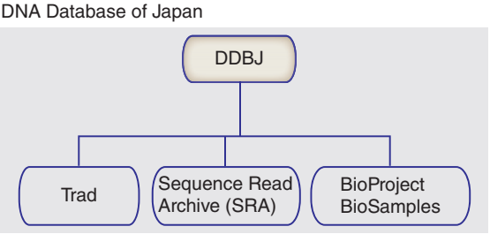
NCBI BLAST
NCBI - National Center for Biotechnology Information
Literally one of the most useful biological tools ever -> BLAST
“The Basic Local Alignment Search Tool (BLAST) finds regions of local similarity between sequences. The program compares nucleotide or protein sequences to sequence databases and calculates the statistical significance of matches. BLAST can be used to infer functional and evolutionary relationships between sequences as well as help identify members of gene families.”
2
Notes:
BIOINFORMATICS AND FUNCTIONAL GENOMICS third edition

Slide 3
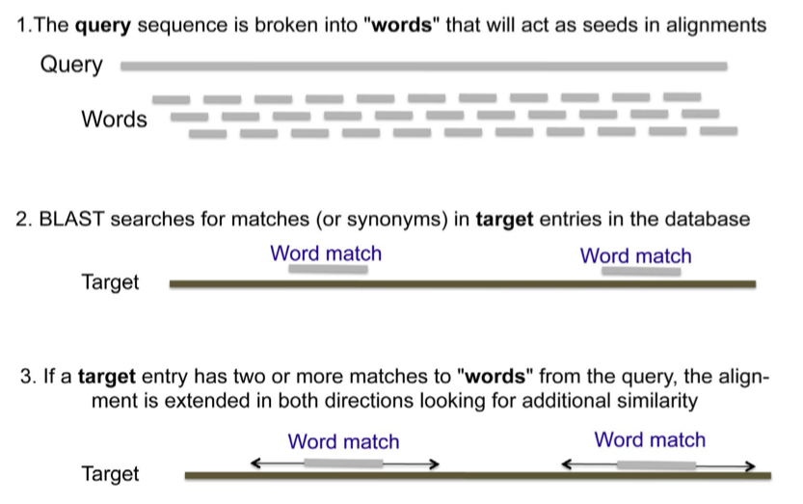
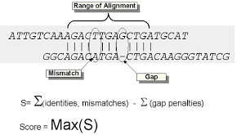
NCBI BLAST
How does BLAST work?
Query (What you’re searching with) broken up into words
Words searched against database of Targets
Once you find a match between words, you expand the alignment in either direction
3
Notes:
https://bio.libretexts.org/Bookshelves/Cell_and_Molecular_Biology/Book%3A_Investigations_in_Molecular_Cell_Biology_(O'Connor)/09%3A_Protein_Conservation/9.04%3A_BLAST_algorithms_are_used_to_search_databases

Slide 4
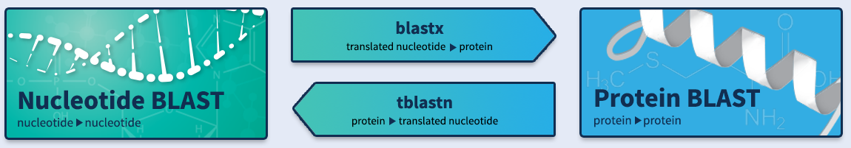
NCBI BLAST
Few different flavors of BLAST
blastn – nucleotide vs nucleotide
blastp – amino acid vs amino acid
blastx – translated nucleotide vs amino acid
tblastn – amino acid vs nucleotide
Different tools for different applications
4
Notes:
https://bio.libretexts.org/Bookshelves/Cell_and_Molecular_Biology/Book%3A_Investigations_in_Molecular_Cell_Biology_(O'Connor)/09%3A_Protein_Conservation/9.04%3A_BLAST_algorithms_are_used_to_search_databases

Slide 5
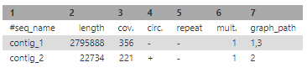
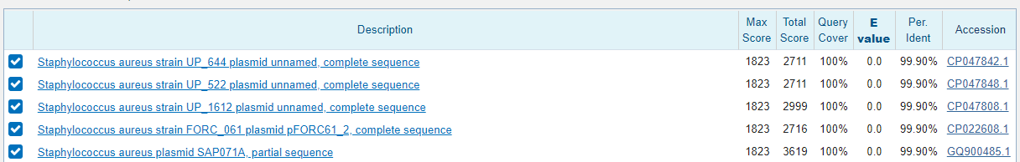
NCBI BLAST
Let’s do a quick example!
Assembled a bacterial genome with Galaxy and Flye (long read assembler) tool
One large contig, nice! What is the smaller one? BLAST it
E value, how likely are you to find a similar alignment in a database of random sequences?
Approaching 0, higher confidence in match
5
Notes:
https://bio.libretexts.org/Bookshelves/Cell_and_Molecular_Biology/Book%3A_Investigations_in_Molecular_Cell_Biology_(O'Connor)/09%3A_Protein_Conservation/9.04%3A_BLAST_algorithms_are_used_to_search_databases

Slide 6
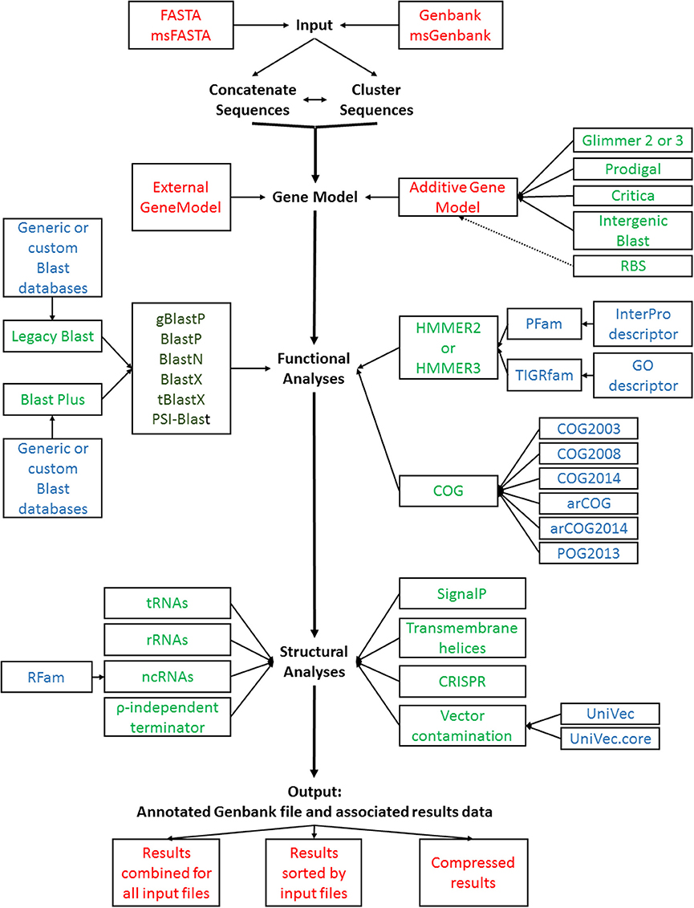
Functional Annotation
BLAST alignment/databases is one of the main pillars of functional annotation
What if we’re studying a newly discovered organism with little homology with others?
What if we want to functionally annotate poorly studied genes?
GAMOLA2,
a Comprehensive Software Package for the Annotation and Curation of Draft and Complete Microbial Genomes
https://www.ncbi.nlm.nih.gov/pmc/articles/PMC5362640/
6
Notes:
GAMOLA2, a Comprehensive Software Package for the Annotation and Curation of Draft and Complete Microbial Genomes

Slide 7
Functional Annotation
How do we interrogate the function of a gene?
Reverse genetics -> Mutate a gene, observe phenotype
Loss of function -> Knock out a gene, observe phenotype
Overexpression -> Make more of a gene product than normal, observe phenotype
Forward genetics -> Collect samples of a specific phenotype (disease), get genotype
Old days -> Restriction fragment length polymorphism (RFLPs)
Now -> Next Generation Sequence(NGS) -> Get SNPs
Gene by gene may take some time for a eukaryotic genome (20-30,000 genes)
7

Slide 8
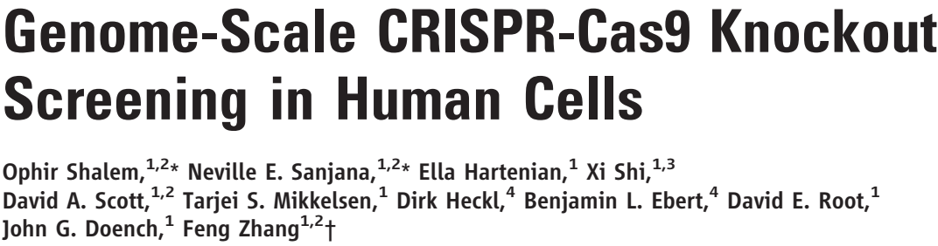
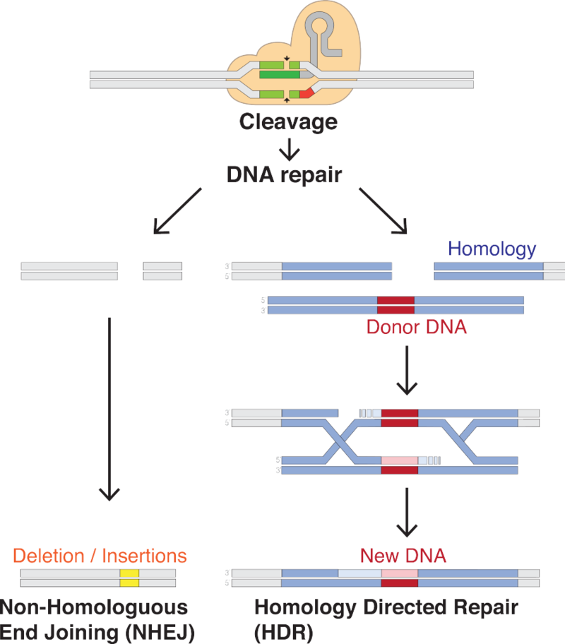

Functional Annotation
How about high-throughput style? Genome-Scale CRISPR Knock-Out (GeCKO)
Interrogate human cancer cell line with a CRISPR library to identify genes responsible for PLX sensitivity
What do I have to understand from this paper???
How did they interrogate every gene in human cells at the same time?
How did they discover a new function of NF2
8
Notes:
Paper #6: Genome-Scale CRISPR-Cas9 Knockout Screening in Human Cells

Slide 9
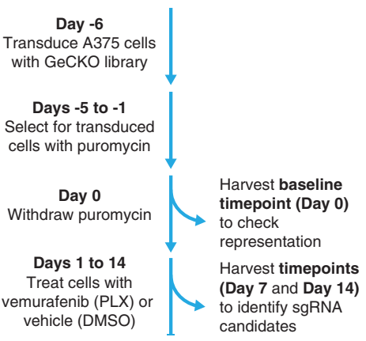
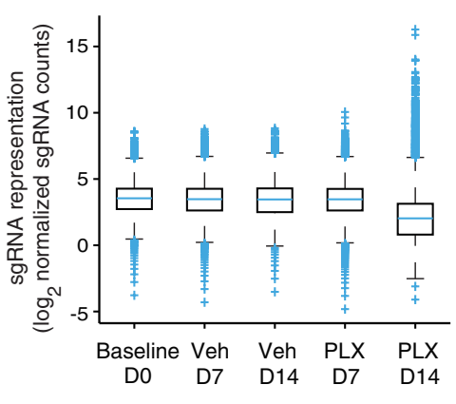
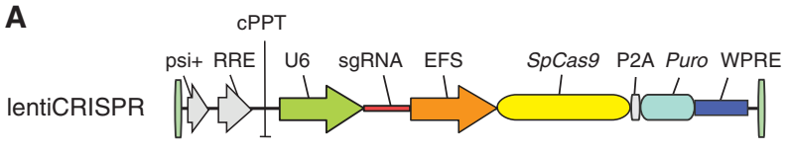
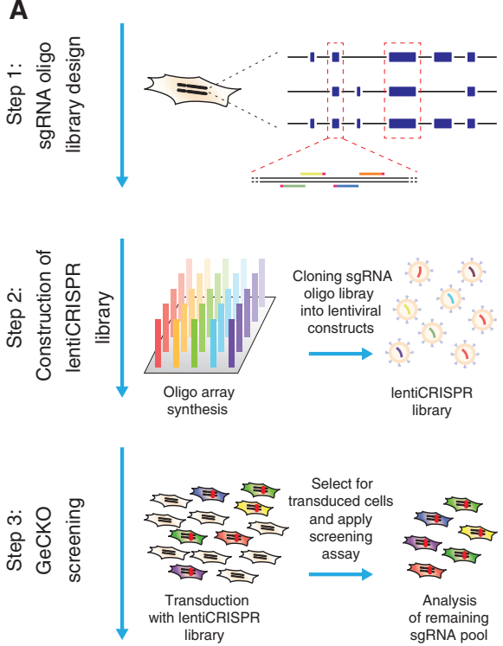
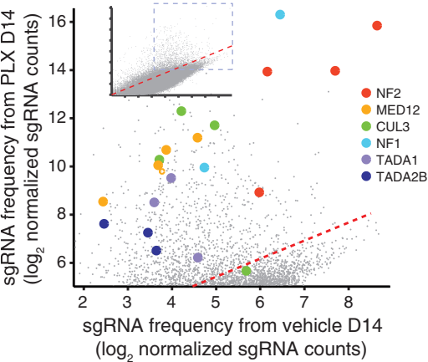
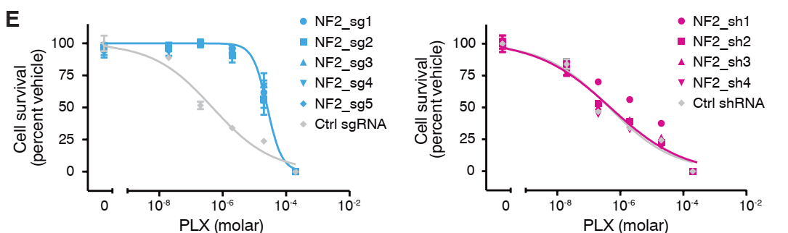
Functional Annotation
9
Notes:
Paper #6: Genome-Scale CRISPR-Cas9 Knockout Screening in Human Cells

Slide 10
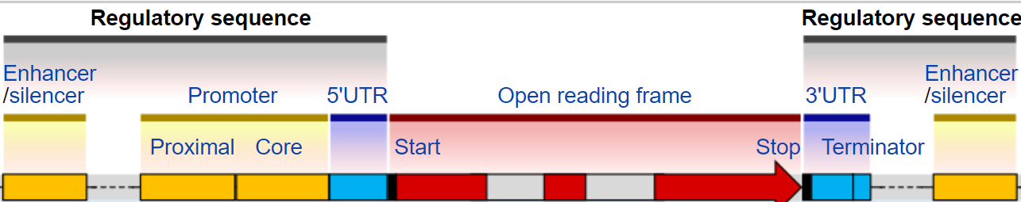
Functional Annotation – DNA/Protein Interactions
We can annotate genes individually or high throughput style through mutations
What about regulatory elements like promoters, activators, enhancers?
How a gene is regulated can determine its function
Proteins bind to specific DNA motifs -> DNA/Protein binding assays
1

Slide 11
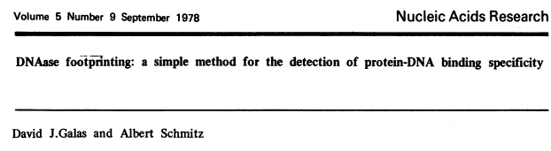
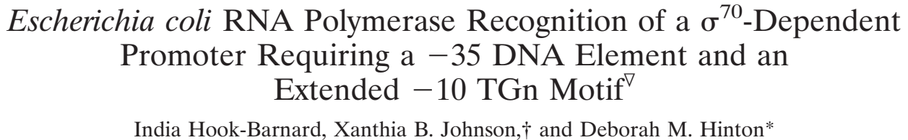
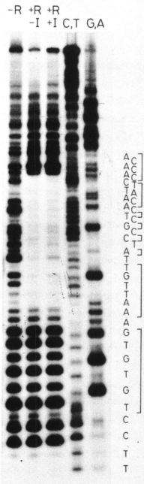
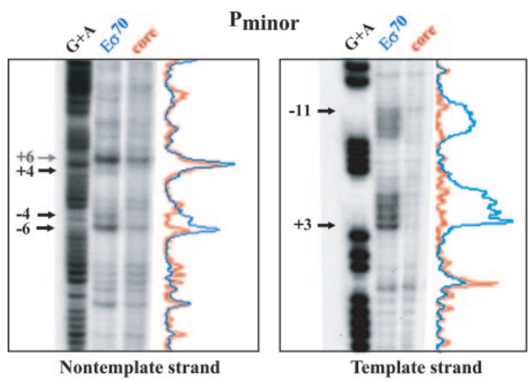
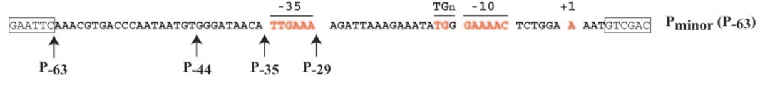
Functional Annotation – DNA/Protein Interactions
How do you actually determine the binding motif of a protein? Footprinting assays
Depending on how you treat DNA/Protein hybrid (DNase, potassium permanganate), enrich for different DNA types
Repressor
2

Slide 12
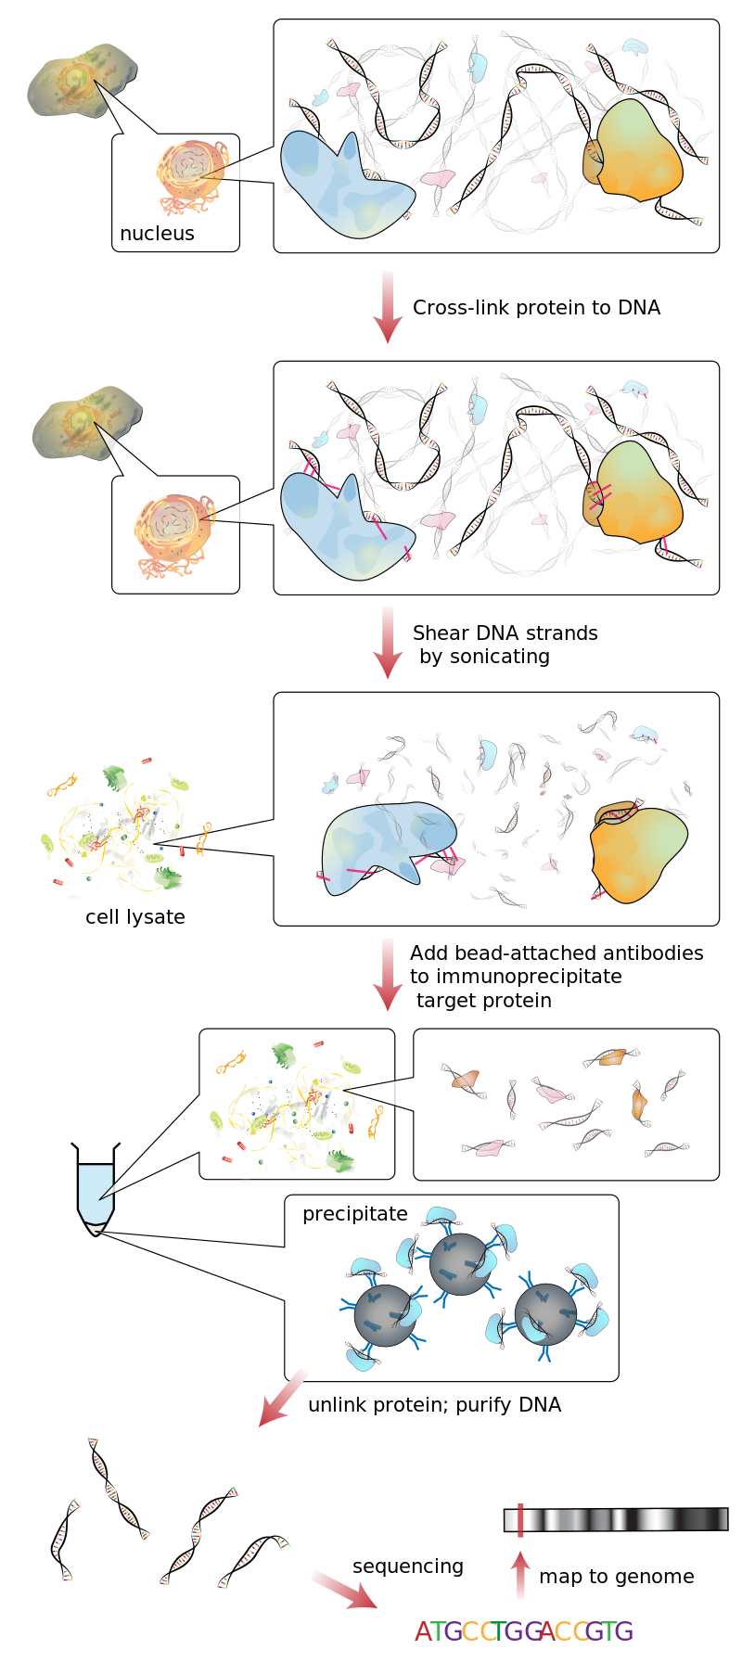
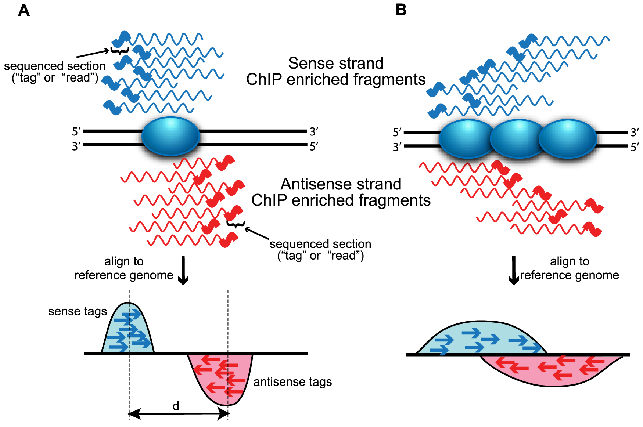
Functional Annotation – DNA/Protein Interactions
Very useful when you have one protein, what’s the high-throughput equivalent?
Chromatin immunoprecipitation sequencing -> ChIP-Seq! Not just for histone proteins!
After sequencing, reads are mapped to the genome and peaks are called
Peaks correspond to protein binding, with possible functional relevance
3
Notes:
Evaluation of Algorithm Performance in ChIP-Seq Peak Detection

Slide 13
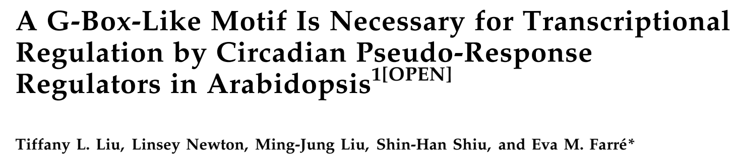
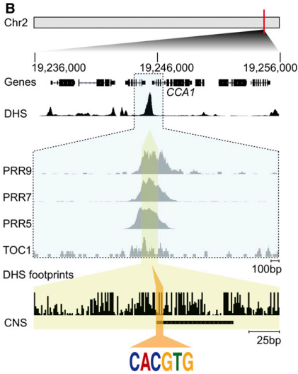
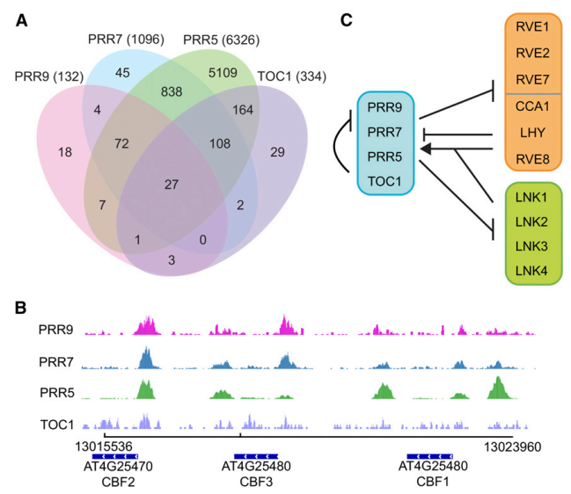
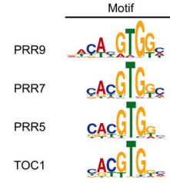
Functional Annotation – DNA/Protein Interactions
Plants need to sense morning and night, circadian patterns controlled by pseudo-response regulators (PRRs)
Which genes are repressed by PRRs?
ChIP-Seq can find genes regulated by the IP’d protein, as well as its consensus binding motif!
4

Slide 14
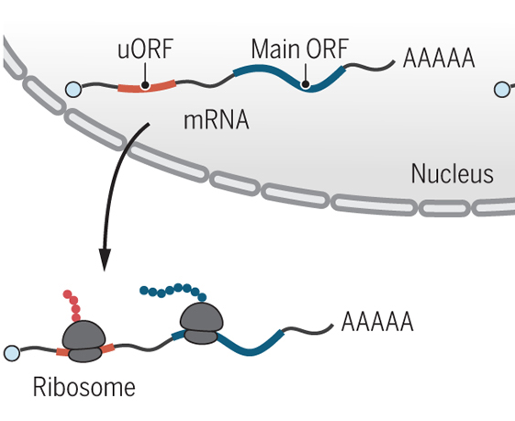
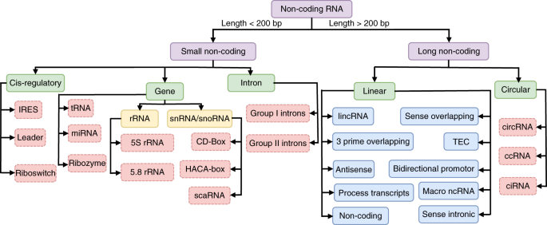
Functional Genomics – The Transcriptome
The transcriptome is the content of ALL RNA in the organism at a given moment in time
Which RNAs are expressed temporally/spatially/under stress can have functional significance
How do we actually detect and measure RNA levels?
5
Notes:
Coding functions of “noncoding” RNAs
Evaluation of deep learning in non-coding RNA classification

Slide 15
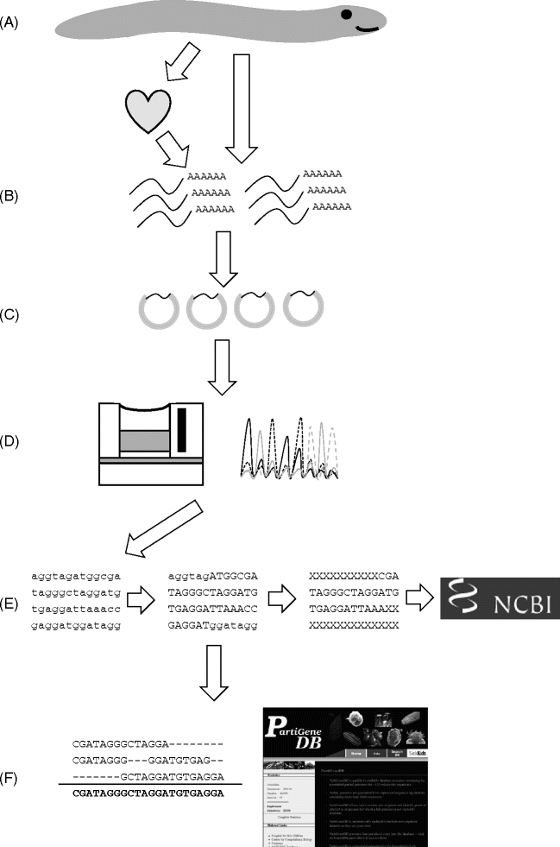
Functional Genomics – The Transcriptome
What did researchers do before NGS was widely available?
Expressed sequence tags (ESTs)
Reverse transcribed the pool of mRNAs, cloned them into small plasmids, sequenced the plasmids
Before Venter started Celera, he worked at NIH -> EST patenting controversy
6
Notes:
Expressed Sequence Tags: An Overview
https://www.ncbi.nlm.nih.gov/books/NBK19867/

Slide 16
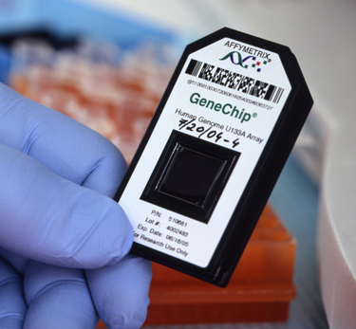
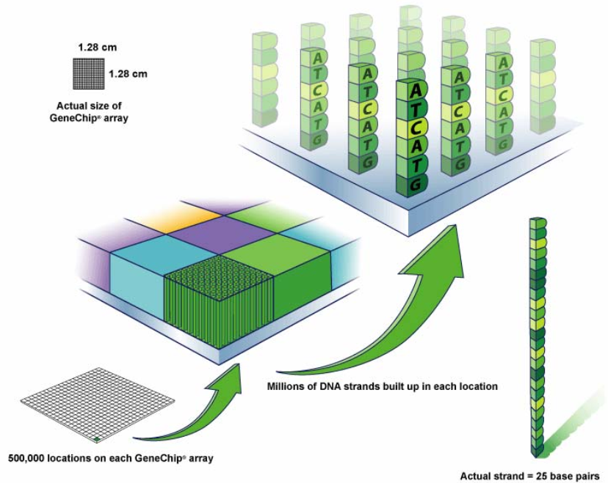
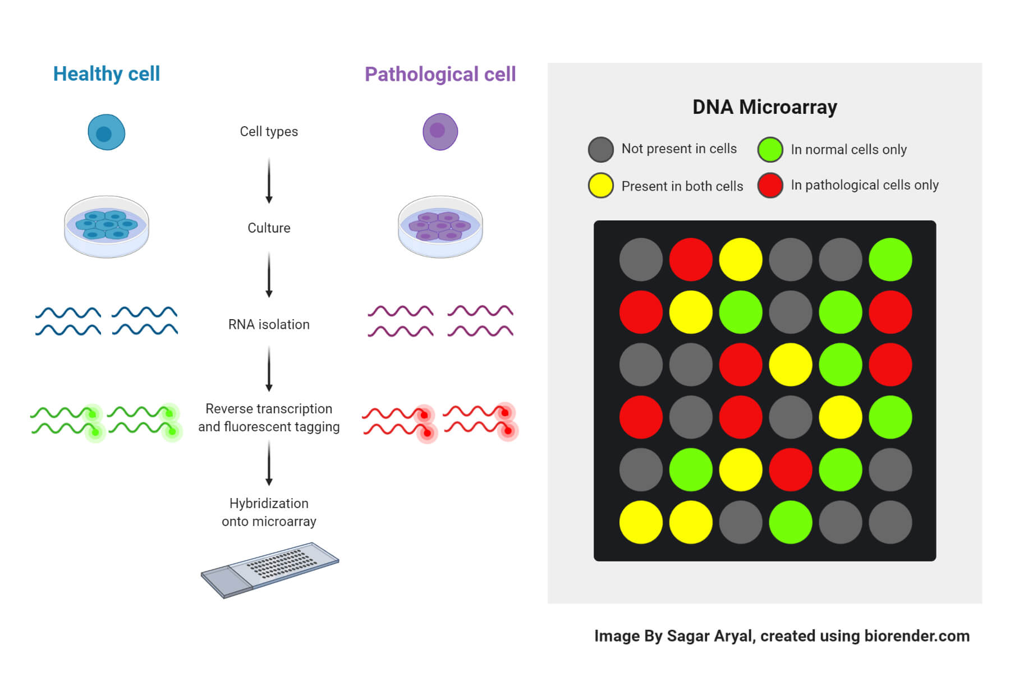
Functional Genomics – The Transcriptome
What came next? Microarrays
Microarray chips have millions of DNA probes hybridized in spots
Apply your dyed cDNA to the chip, take a picture with a camera, count the dots!
Less flexible than RNA-seq, you can only observe previously identified transcripts (no novel or low abundance RNAs)
Cost per sample is still cheaper than RNA-seq, simpler workflow, straightforward analysis
Clinical cancer genotyping? Organ transplantation? Still using microarrays
7

Slide 17
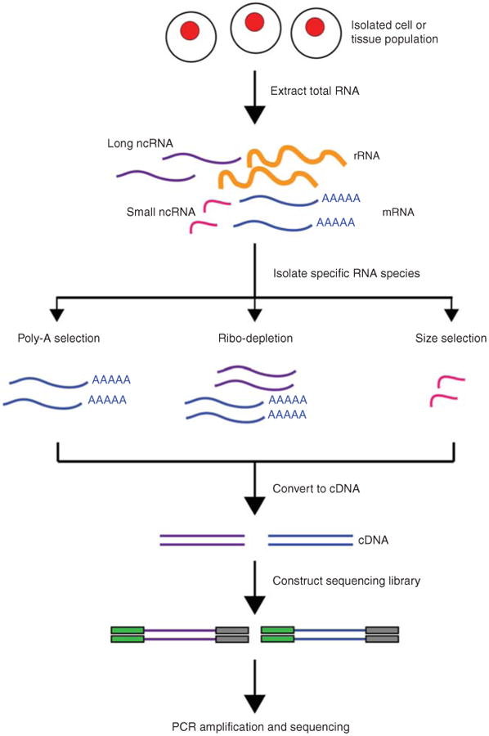
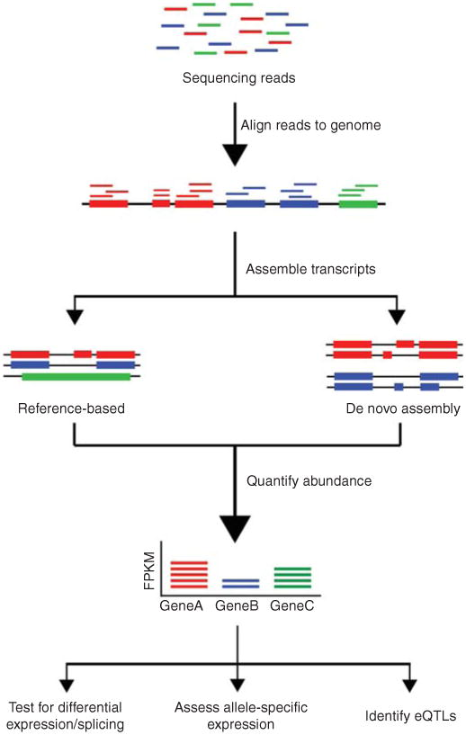
Functional Genomics – The Transcriptome
As soon as 2nd generation NGS technologies were developed, RNA-seq was born
8

Slide 18
Functional Genomics – The Transcriptome
As soon as 2nd generation NGS technologies were developed, RNA-seq was born
What can we actually do with RNA-seq?
1

Slide 19
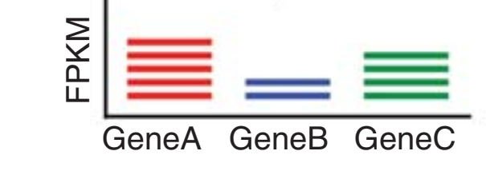
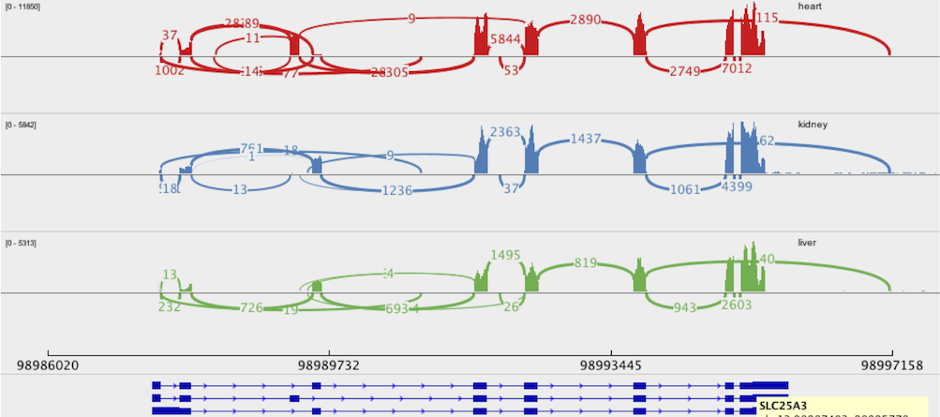
Functional Genomics – The Transcriptome
Three common applications of RNA-seq, usually performed in the same experiment
1) Differential expression (DE) analysis
“Which genes contribute to drought tolerance”
“Which genes are upregulated in cancer tissues”
Comparing an experimental sample vs a control
Identify differentially expressed genes (DEGs)
Gene A -> Upregulated, Gene B -> Downregulated, Gene C -> No change
2) Splicing analysis
“Which isoforms of a gene are expressed under salt stress”
Sashimi plots
3) Novel gene identification
Un-annotated transcripts? Could be a new gene!!!
Normalized
Reads
Normalized
Reads
Control
Experimental
2

Slide 20
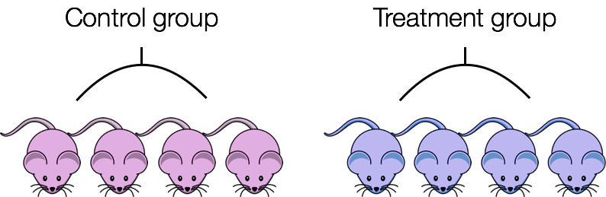
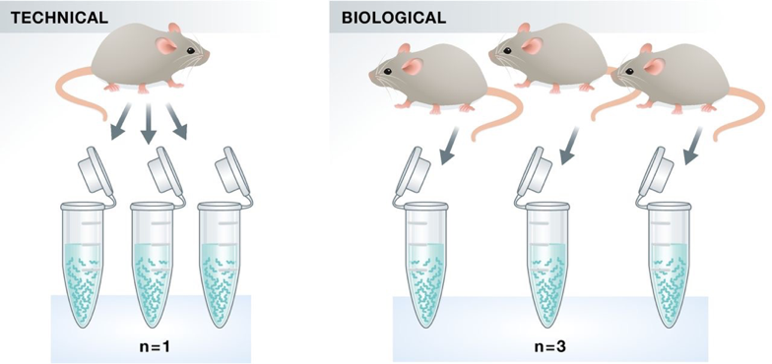
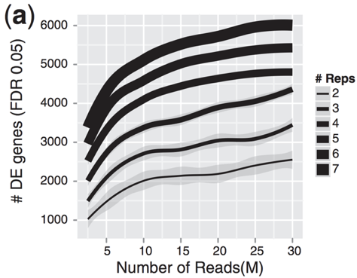
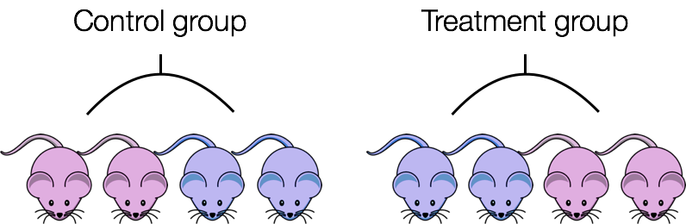
Functional Genomics – The Transcriptome
What are the key steps in a good RNA-seq experiment?
Starts before you even hit the bench -> Experimental design
Replicates -> Technical and biological
Technical -> Correcting for variation in sample prep, machine, operator error
Biological -> Correcting for variation between cells/tissues/individuals
More biological replicates -> More power to detect DE genes
Careful with confounding variables -> Sex of mice, age of plants…keep it consistent
Or
3
Notes:
http://scotty.genetics.utah.edu/help.html
https://hbctraining.github.io/Intro-to-rnaseq-hpc-salmon/lessons/experimental_planning_considerations.html
RNA-seq differential expression studies: more sequence or more replication?

Slide 21
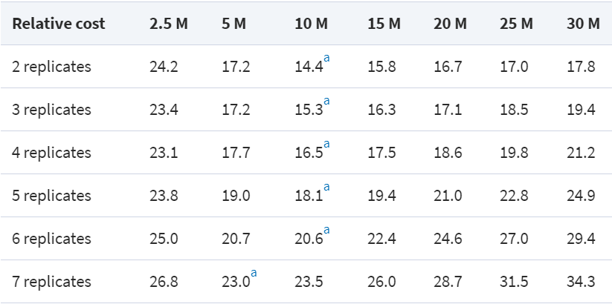
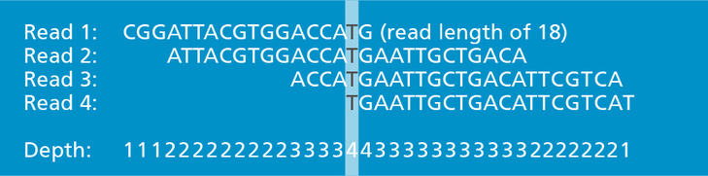
Functional Genomics – The Transcriptome
Read depth -> How many times a nucleotide in the transcriptome/genome has been sequenced
-> How many unique reads align to a given nucleotide
- Sequencing reactions are done in lanes, finite limit to reads/lane (depending on technology)
How much read depth do you need?
DE analysis of highly expressed genes? Don’t need that much, 5-25 million reads
Low abundance genes? Alternative splicing? 30-60 million
De novo transcriptome assembly? 100-200 million reads
Diminishing returns with more depth -> Better to have more biological replicates
4
Notes:
http://scotty.genetics.utah.edu/help.html
https://hbctraining.github.io/Intro-to-rnaseq-hpc-salmon/lessons/experimental_planning_considerations.html
RNA-seq differential expression studies: more sequence or more replication?

Slide 22
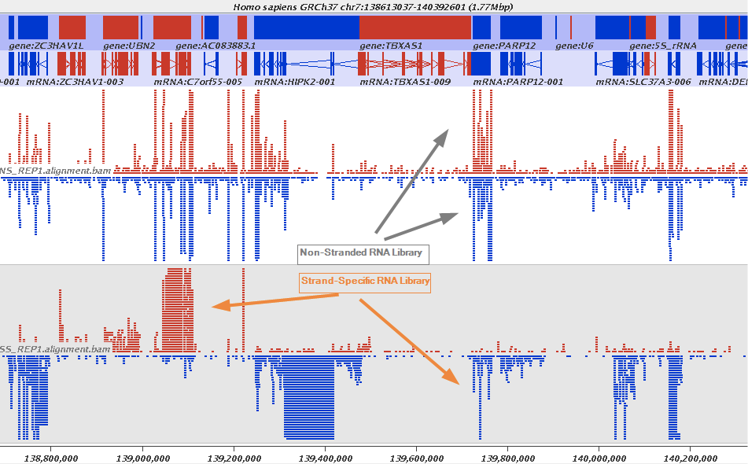
Functional Genomics – The Transcriptome
Read length -> Very goal dependent
Micro RNAS (20-30bp) – 1x50bp reads, one read will cover an entire micro RNA and then some
Counting transcripts (DE) – 1x50 to 1x75, you don’t want a ton of reads mapping into introns
Alternative splicing – 2x150, 2x300, you want information about splice sites
Stranded or unstranded?
Quantify genes with overlapping loci on different strands
5
Notes:
http://scotty.genetics.utah.edu/help.html
https://hbctraining.github.io/Intro-to-rnaseq-hpc-salmon/lessons/experimental_planning_considerations.html
RNA-seq differential expression studies: more sequence or more replication?

Slide 23
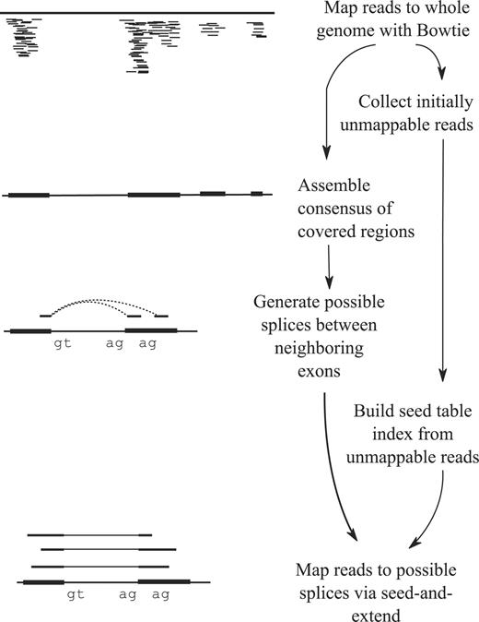
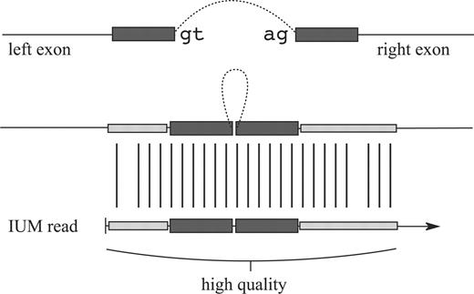
Functional Genomics – The Transcriptome
You design your experiment and perform the sequencing, left with a pile of reads, now what?
Mapping your reads!
Genome guided mapping
Most transcripts will be in mRNA form during RNA-seq, how to map reads that cross two exons?
6

Slide 24
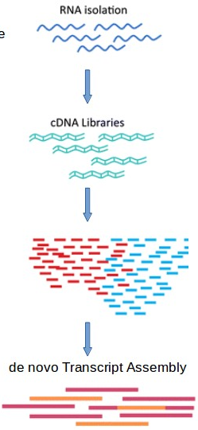

Functional Genomics – The Transcriptome
No reference genome?
De novo transcriptome assembly -> Construct RNA contigs -> Uses De Brujin graphs!
Much more difficult to get splicing information from a de novo transcriptome assembly
Reads aligned back to assembled transcripts for counting
7

Slide 25



Functional Genomics – The Transcriptome
Mapped our reads back to our genome or our de novo assembled transcripts, can we answer some biological questions???
Not yet! We need to normalize our data! Several factors can throw off comparison of counts between and within samples
What are some ways researchers have developed to account for this?
Sequencing Depth
Gene Length
RNA Composition
8
Notes:
https://hbctraining.github.io/DGE_workshop/lessons/02_DGE_count_normalization.html

Slide 26
Functional Genomics – The Transcriptome
Different mathematical transformations!
Easy to misuse RPKM/FPKM/TPM, not for comparing between samples of different groups
You’ll be using DESeq2 for Assignment 2
Normalization method | Description | Accounted factors | Recommendations for use
CPM (counts per million) | counts scaled by total number of reads | sequencing depth | gene count comparisons between replicates of the same samplegroup; NOT for within sample comparisons or DE analysis
TPM (transcripts per kilobase million) | counts per length of transcript (kb) per million reads mapped | sequencing depth and gene length | gene count comparisons within a sample or between samples of the same sample group; NOT for DE analysis
RPKM/FPKM (reads/fragments per kilobase of exon per million reads/fragments mapped) | similar to TPM | sequencing depth and gene length | gene count comparisons between genes within a sample; NOT for between sample comparisons or DE analysis
DESeq2’s median of ratios [1] | counts divided by sample-specific size factors determined by median ratio of gene counts relative to geometric mean per gene | sequencing depth and RNA composition | gene count comparisons between samples and for DE analysis; NOT for within sample comparisons
EdgeR’s trimmed mean of M values (TMM) [2] | uses a weighted trimmed mean of the log expression ratios between samples | sequencing depth, RNA composition, and gene length | gene count comparisons between and within samples and for DE analysis
9
Notes:
https://hbctraining.github.io/DGE_workshop/lessons/02_DGE_count_normalization.html

Slide 27

Functional Genomics – The Transcriptome
So, we map our reads, count them, normalize the counts, compare counts between samples
What do we get back??? THE LIST!!! (Of DEGs…)
Now we can start analyzing the data
What specific genes are up/down regulated?
Can we assign genes to specific functions/pathways? GO analysis
10
Notes:
https://hbctraining.github.io/DGE_workshop/lessons/02_DGE_count_normalization.html

Slide 28
Functional Genomics – The Transcriptome
So, we map our reads, count them, normalize the counts, compare counts between samples
What do we get back??? THE LIST!!! (Of DEGs…)
Now we can start analyzing the data
What specific genes are up/down regulated?
Can we assign genes to specific functions/pathways? GO analysis
1
Notes:
https://hbctraining.github.io/DGE_workshop/lessons/02_DGE_count_normalization.html

Slide 29
Functional Genomics – The Transcriptome
What’s this fold change thing, anyway? “Gene X had a fold change of Y under Z treatment”
Gene X Normalized counts under control treatment -> 100
Gene X Normalized counts under experimental treatment -> 400
Fold change is ratio of Experimental/Control, 400/100 is 4, or a FC of 4 -> “Gene X is 4 fold/4 times more abundant under Z treatment”
Log2(FC) = 3.809, FC = 2^3.809 = ~14 times more abundant!!!
A negative log2(FC) or a FC < 1 means that Gene X was LESS abundant (down-regulated) in experimental sample
2
Notes:
https://hbctraining.github.io/DGE_workshop/lessons/02_DGE_count_normalization.html

Slide 30
Functional Genomics – The Transcriptome
How about the p-value? And false discovery rate (FDR) adjusted p-value (AKA q-value)
P-value of 0.05 -> 5% chance that all tests will be false positives
In list of 10,000 genes, 500 would be set as DE by accident -> Not great
Lets say we adjust the p-value by performing FDR significance testing of those p-values -> q-value
Q-value of 0.05 > 5% chance that all significant tests will be false positives -> Much smaller number of false positives
How are they adjusted? False discovery rate -> Benjamini-Hochberg procedure
3

Slide 31


Functional Genomics – The Transcriptome
What FC and q-value should be my cut-off?
Set cut-off at 2? Genes need to be over/under-expressed by 2X to have a biological function? (Not always)
Cut-off of q-value at 0.1, 0.05, 0.01?
Depends on your analysis, needs to be adjusted rather than rigid
I.e. Broad pathway analysis with gene ontology (GO)? Keep the q-value cut-off loose, same with FC
I.e. Going to validate your RNA-seq with wet-lab experiments? Tighten up q-value, pick genes with a high FC
4
Notes:
Normalization of QRT-PCR data: The necessity of adopting a systematic, experimental conditions-specific, validation of references

Slide 32

Functional Genomics – The Transcriptome
If you’re studying a well-annotated organism, interested in a few specific genes, easy to pick out
“The defensin transcript was overexpressed 4 fold when sprayed with jasmonic acid”
What about a global view?
Gene ontology (GO) analysis!!! Assign ALL your DEGs to pathways!
“An ontology is a formal representation of a body of knowledge within a given domain. Ontologies usually consist of a set of classes (or terms or concepts) with relations that operate between them.”
Applying what we currently know about biology to a list of genes using a defined vocabulary
5
Notes:
http://geneontology.org/docs/ontology-documentation/

Slide 33

Functional Genomics – The Transcriptome
GO analysis is broken up into 3 ontologies, 3 different ways to describe a gene
Molecular Function – Activities that occur at the molecular level, “Catalytic activity”, “Transporter activity”
Cellular Component – Where does the gene function occur? Compartment/complex, “Mitochondrion”, “Ribosome”
Biological Process – Larger, broader biological processes, multiple components, “Transcription”, “Signal transduction”
Cytochrome C -> Molecular function -> Oxidoreductase activity
-> Biological process -> Oxidative phosphorylation
-> Cellular component -> Mitochondrial matrix
6
Notes:
http://geneontology.org/docs/ontology-documentation/
https://www.ebi.ac.uk/training-beta/online/courses/goa-and-quickgo-quick-tour/what-is-go/

Slide 34


Functional Genomics – The Transcriptome
Terms (Classes) sound pretty broad? GO uses a hierarchy of terms with relationships
Less specific concepts -> Parents, More specific -> Children
7
Notes:
http://geneontology.org/docs/ontology-documentation/
https://www.ebi.ac.uk/training-beta/online/courses/goa-and-quickgo-quick-tour/what-is-go/

Slide 35


Functional Genomics – The Transcriptome
What do we actually use GO for???
Find significantly over-represented terms in a specific set of query genes (I.e. DEGs from an infected plant)
We will use PANTHER (Protein ANalysis THrough Evolutionary Relationships) Classification System for assignment 2
We can also annotate and infer an unknown gene’s function based on homology
De novo assembly -> Putative transcript -> blastx -> GO
8
Notes:
http://geneontology.org/docs/ontology-documentation/
https://www.ebi.ac.uk/training-beta/online/courses/goa-and-quickgo-quick-tour/what-is-go/
http://pantherdb.org/

Slide 36





Functional Genomics – The Transcriptome
RNA-Seq, DE analysis, GO enrichment -> Technical challenges that can be overcome
Getting real biological meaning an building a story is the real work
GO analysis is a good hypothesis GENERATING machine
So there’s a lot of catalytic activity…
…acting on a proteins…
…involved in oxygen incorporation…
“So…like…plants respond to
infection by modulating gibberellin
synthesis, which is a plant
hormone, responsible for growth…
So more growth means a thicker cell wall to defend against attack??”
Okay…How would you test that?
…oxoglutarate oxygenase??
Gibberelin synthesis?
Literature search…
9
Notes:
http://geneontology.org/docs/ontology-documentation/
https://www.ebi.ac.uk/training-beta/online/courses/goa-and-quickgo-quick-tour/what-is-go/
http://pantherdb.org/

Slide 37
Functional Genomics – The Transcriptome
RNA-Seq, DE analysis, GO enrichment -> Technical challenges that can be overcome
Getting real biological meaning an building a story is the real work
GO analysis is a good hypothesis GENERATING machine
So there’s a lot of catalytic activity…
…acting on a proteins…
…involved in oxygen incorporation…
“So…like…plants respond to
infection by modulating gibberellin
synthesis, which is a plant
hormone, responsible for growth…
So more growth means a thicker cell wall to defend against attack??”
Okay…How would you test that?
…oxoglutarate oxygenase??
Gibberelin synthesis?
Literature search…
1
Notes:
http://geneontology.org/docs/ontology-documentation/
https://www.ebi.ac.uk/training-beta/online/courses/goa-and-quickgo-quick-tour/what-is-go/
http://pantherdb.org/

Slide 38


Functional Genomics – The Transcriptome
Resources exist to integrate our DEGs into pathways
KEGG – Kyoto Encyclopedia of Genes and Genomes!
Similar in some ways to GO, but more of a focus on visualizing pathways
Database for Annotation, Visualization and Integrated Discovery (DAVID) -> Integrates GO, KEGG etc
Really useful for picking targets for biological validation/reverse genetics
Knock out a gene upstream/downstream of your DEG, see the effects
2
Notes:
http://geneontology.org/docs/ontology-documentation/
https://www.ebi.ac.uk/training-beta/online/courses/goa-and-quickgo-quick-tour/what-is-go/
http://pantherdb.org/

Slide 39


Functional Genomics – The Transcriptome
Pokeweed -> Non-model plant, genome wasn’t sequenced at that time – De novo transcriptome assembly
Pokeweed antiviral protein -> Effective against plant and animal viruses -> Several isoforms
Spraying pokeweed plants with jasmonic acid (JA) -> Induce stress response
What do I have to understand from this paper???
How did the authors account for variability between plants?
Which specific genes were the authors interested in characterizing?
What novel aspects of PAP biology/regulation did the RNA-seq uncover?
3
Notes:
Paper #7: The Pokeweed Leaf mRNA Transcriptome and its Regulation by Jasmonic Acid

Slide 40



Functional Genomics – The Transcriptome
Accounting for variability happens during experimental design!
Heat maps are a good way of getting a overview of gene expression under your treatment
Venn diagrams -> How many DEGs are unique to a specific treatment?
4

Slide 41



Functional Genomics – The Transcriptome
Not only did we find which PAP isoforms are responsive to JA, we found some new isoforms!
Stranded sequencing came in handy to identify natural antisense transcripts (NATs)
NATs can generate siRNAs -> fine tune gene regulation
5
Notes:
NATpare: a pipeline for high-throughput prediction and functional analysis of nat-siRNAs

Slide 42





Functional Genomics – The Transcriptome
What are some other applications of RNA-seq?
Enrich for 5’ ends of complete mRNA -> Cap-Analysis gene expression (CAGE)
CAGE can reveal complex promoter structures -> Alternative start sites to produce mRNA isoforms
6
Notes:
5’ end-centered expression profiling using Cap-analysis gene expression (CAGE) and next-generation sequencing

Slide 43




Functional Genomics – The Transcriptome
Small RNA sequencing -> Find novel small RNAs
Validate cleavage sites with 5’ rapid amplification of cDNA ends (RACE)? Do-able for a handful of genes
Genome wide identification of cleaved RNA -> PARE-seq -> “Degradome seq”
7

Slide 44



Functional Genomics – The Transcriptome
RNA-seq captures the steady state of RNA in an organism, not short lived RNA species (Un-capped, no poly A tail, etc)
Enhancer RNAs -> Transcribed from enhancer regions, bring together distal regions
Long intergenic non-coding RNAs, miRNAs…
Global nuclear run-on sequencing (GRO-seq)
GRO-Seq reveals regulatory RNAs that we would have never seen before!
8
Notes:
Nascent RNA sequencing reveals distinct features in plant transcription

Slide 45
Functional Genomics – The Transcriptome
RNA-seq and derivative methods have contributed to our understanding of the functional elements of the genome
Different methods to functionally annotate our genome
Next up -> High-throughput proteomics!
+1 TSS
CAGE-Seq
RNA-Seq
GRO-Seq
ChIP-Seq
RNA-Seq
GRO-Seq
RNA-Seq
GRO-Seq
9

Slide 46
Functional Genomics – The Proteome
We have explored the functional aspects of the genome and transcriptome
Our last step in functional genomics -> Proteome
The proteome is the sum total of proteins produced in the organism
Tools exist to study function of ONE protein, but what about all proteins in concert?

Slide 47

Functional Genomics – The Proteome
Studying the proteome of an organism is more difficult than sequencing the genome or transcriptome
Fewer tools analogous to PCR, NGS etc
We can get the sequence of a known protein from a genome…but what if it’s an unknown protein?
Sequencing of a protein was done before sequencing of DNA -> Also by Sanger!
Limited to sequencing peptides 30-50 amino acids long
Length of peptide sequence can be increased by digestion with proteases
Not suited for high-throughput analysis

Slide 48




Functional Genomics – The Proteome
What came next? Mass spectrometry of proteins!
Mass spectrometers measure mass to charge ratios of molecules passed through them
Complicated mixtures of proteins -> 1D or 2D gel electrophoresis (isoelectric point vs size)
Most proteins are too big to be put directly into a mass spec -> Fragmented by proteases, typically trypsin (trypsin digest)
Notes:
Proteomics and peptidomics: moving toward precision medicine in urological malignancies https://www.creative-proteomics.com/blog/index.php/two-dimensional-gel-electrophoresis-2-de/

Slide 49


Functional Genomics – The Proteome
Peptides are separated through liquid chromatography -> 2 stages of mass spectrometery -> LC MS/MS
Experimental spectra are matched against theoretical spectra
Matching peptides to peptides
Like RNA-seq, a protein mass spec leaves you with a list -> GO, KEGG
Notes:
Protein Mass Spectrometry Made Simple

Slide 50


Functional Genomics – The Proteome
What’s the practical application of mass spec based proteomics?
Biomarker discovery for human cancers!
Exosomes contain proteins excreted by cells, can be detected in many human fluids, cancer cells tend to overproduce them
Compare healthy and diseased exosomes with mass spec analysis, pick out differentially expressed proteins
Ability to detect cancers in less invasive ways
Notes:
Urinary exosomal proteins as (pan-)cancer biomarkers: insights from the proteome

Slide 51

Functional Genomics – The Proteome
We can tell which proteins are within a sample with mass spec, but what do they interact with?
Combine immunoprecipitation with mass-spec! (Affinity purification and mass spectrometry, AP-MS)
Proteins often work in complexes to perform their function
Arabidopsis thaliana nonhost resistant protein 2A/B (AtNHR2A/B) induced in response to pathogen infection
What do I have to understand from this paper???
How did researchers construct an interaction network of MD3?
How did researchers validate the predicted protein-protein interactions?
Notes:
Paper #8: The Arabidopsis Proteins AtNHR2A and AtNHR2B Are Multi-Functional Proteins Integrating Plant Immunity With Other Biological Processes

Slide 52

Functional Genomics – The Proteome
Notes:
The Arabidopsis Proteins AtNHR2A and AtNHR2B Are Multi-Functional Proteins Integrating Plant Immunity With Other Biological Processes

Slide 53

Functional Genomics – The Proteome
Notes:
The Arabidopsis Proteins AtNHR2A and AtNHR2B Are Multi-Functional Proteins Integrating Plant Immunity With Other Biological Processes

Slide 54

Functional Genomics – The Proteome
Notes:
The Arabidopsis Proteins AtNHR2A and AtNHR2B Are Multi-Functional Proteins Integrating Plant Immunity With Other Biological Processes

Slide 55

Functional Genomics – The Proteome
Notes:
The Arabidopsis Proteins AtNHR2A and AtNHR2B Are Multi-Functional Proteins Integrating Plant Immunity With Other Biological Processes

Slide 56

Functional Genomics – The Proteome
Notes:
The Arabidopsis Proteins AtNHR2A and AtNHR2B Are Multi-Functional Proteins Integrating Plant Immunity With Other Biological Processes

Slide 57

Co-IP: Co-Immunoprecipitation

Slide 58


Functional Genomics – The Proteome
Yeast 2-hybrid can also detect protein-protein interactions
Activator domain and binding domain brought together by bait and prey proteins, activate transcription of a reporter gene
Protein of interest in bait plasmid, cDNA library in prey plasmid, co-transform -> NGS on colonies that survive
Yeast 2-hybrid detects stable protein interactions, not transient
Notes:
A user-friendly platform for yeast two-hybrid library screening using next generation sequencing

Slide 59


Functional Genomics – The Proteome
Yeast 2-hybrid is a well proven technology, suffers from high false positive rate
Proteins may not fold the same in yeast as in humans/plants etc
BioID method – Fusing your protein of interest to a promiscuous biotin ligase (BirA), pulling down biotinylated proteins
Biotinylation happens very quickly in a 10nm radius, labeling transient and weak interactions
Notes:
A promiscuous biotin ligase fusion protein identifies proximal and interacting proteins in mammalian cells

Slide 60


Functional Genomics – The Proteome
Bio-ID can identify transient interactions in vivo in the native context
Researchers were looking for host proteins which interact with Tobacco mosaic virus (TMV) replicase
What do I have to understand from this paper???
How did researchers find proteins that interacted with the replicase
How did they verify one possible model of host/viral protein interaction?
Why could the authors not directly link the host and viral protein?
Notes:
Paper #9: In planta proximity-dependent biotin identification (BioID) identifies a TMV replication co-chaperone NbSGT1 in the vicinity of 126 kDa replicase

Slide 61



Functional Genomics – The Proteome
BirA fused at N and C terminus of replicase, expressed in TMV infected plants
Chose NbSGT1 for further validation, associated with hypersensitive response (HR) in plants with Heat shock proteins (HSPs)
HSPs also involved with viral replication
Notes:
Paper #9: Paper In planta proximity-dependent biotin identification (BioID) identifies a TMV replication co-chaperone NbSGT1 in the vicinity of 126 kDa replicase

Slide 62



Functional Genomics – The Proteome
Authors used a tobacco rattle virus (TRV) based virus induced gene silencing vector (VIGS) to knock down SGT1
You can also use TRV for overexpression of proteins
Y2H and BiFC assay suggest weak/indirect interaction
Notes:
Paper #9: Paper In planta proximity-dependent biotin identification (BioID) identifies a TMV replication co-chaperone NbSGT1 in the vicinity of 126 kDa replicase

Slide 63


Assignment #2
You will be performing your own differential expression analysis with real data!
>4000 species of plant parasitic nematodes
Collectively, these nematodes cause >$80 billion in damage to agricultural crops worldwide every year
Most live in soil and damage plant roots
Burrowing nematodes in red clover roots
Tree die-off caused by pine wilt nematode
Root knot nematode damage in tomato

Slide 64


Assignment #2
Read the paper, questions regarding goals of researchers + experimental design on assignment
Compared response of wild type plants (Columbia-0) and cytokinin hypersensitive (arr3,4,5,6,7,8,9,15) to nematode infection
Cytokinins are plant hormones responsible for plant growth and response to biotic/abiotic stress
We will take a sub-set of their data to answer our own question -> How do plants respond to beet cyst nematode infection?
Our dataset:
Wild-type plants
4 days
WT-INF1
WT-INF2
WT-INF3
WT-CON1
WT-CON2
WT-CON3
Isolated RNA from roots
Performed RNA-seq using an Illumina HiSeq2500
50 nt single-end reads

Slide 65




Assignment #2
Shanks et al. (2016) deposited sequence data to NCBI. What NCBI Bioproject number is associated with this work?
Use keywords to find the paper and the associated bioproject, get details on the experimental design (or read the paper)

Slide 66


Assignment #2
You’ll retrieve the Control_1 replicate and do some basic QC
What does quality mean in terms of a fastq file?
Base = T
Quality score = “:” = 25
Quality score represents confidence that a particular base is called correctly:
Quality score X = error probability of 10^{-X/10}
Quality score of 25 ⁼ 10^{-25/10} = 10^{-2.5} = ~0.003 probability of base call error

Slide 67






Assignment #2
Check the quality before doing analysis!!!
FastQC -> # reads, sequence lengths, N number, base quality scores across all reads, Adapter sequence contamination

Slide 68


Assignment #2
After trimming your reads, you’ll be aligning them to the reference genome (A. thaliana)
You will use an intron aware aligner -> HISAT2
HISAT2 outputs BAM files (Binary Alignment/Mapping)
FeatureCounts takes each mapped read and assigns it to a specific gene
Uses the match coordinates in the BAM file and the precise gene exon coordinates defined by the Arabidopsis genome annotation (GTF) file

Slide 69


Assignment #2
You will perform DE analysis with DESEQ2
DESEQ2 normalizes your read counts -> Why?
Produces a p-value and adjusted p-value for each gene
Outputs some useful plots too!
MA plot- Counts (expression level) vs. fold-change; colored dots are statistically significant differences
PCA plots - Method to visualize overall data similarity between samples; groupings based on treatment are expected

Slide 70
Assignment #2
Due 5pm, Monday, November 23rd.
Points given for grammar, spelling, care given to pictures
Provide your shared histories link at the end of your assignment
Galaxy North America and Galaxy Europe are running smoothly, Australia a bit slower, doable on all.
Test #2
1h 30m, long answer and multiple choice
Module 2, Parts 1 to 6
Switching between questions will not be enabled, prepare yourself mentally

